Slide 1
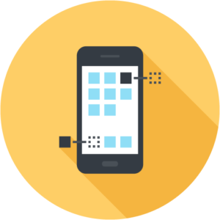
Mobile Application Development
2023-24
1

Slide 2
Well designed services
In the real world, products and services are made of tangible hardware and software but inside consumer’s minds they are mainly made of experiences (UX, User eXperience)
If a product doesn't work as a person thinks it should do, the person will be frustrated even if he/she will be able to successfully perform the given task

Slide 3
Bad design: service abandon
If the UX is negative, the user can decide to abandon the app
25% apps are opened once and then abandoned
48% apps are only used 10 times

Slide 4
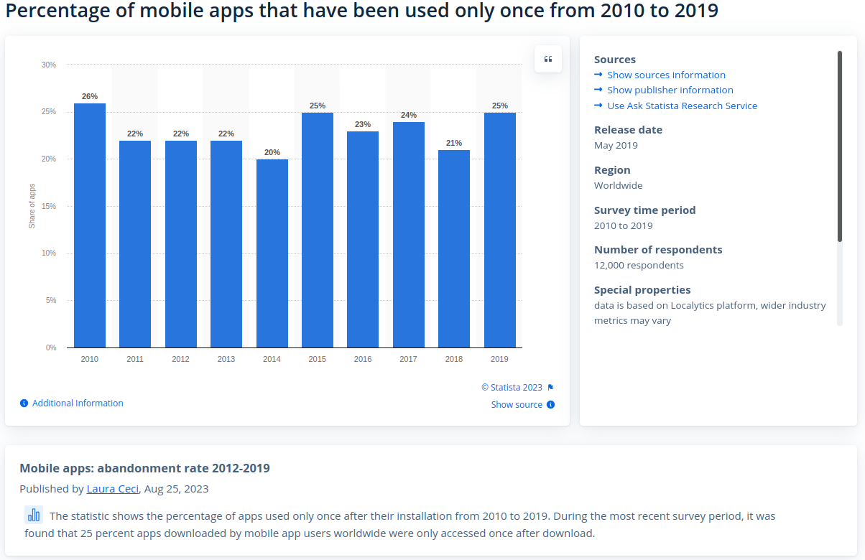
https://www.statista.com/statistics/271628/percentage-of-apps-used-once-in-the-us/

Slide 5


Mobile design
Designing an app is a complex process and requires to:
take into account the context of use (mobility, attention level, stress situation)
consider the typical user interactions (touch gestures, thumb rule, pattern)
make the tasks easy and mobile oriented (display size, web speed, battery)
vs

Slide 6
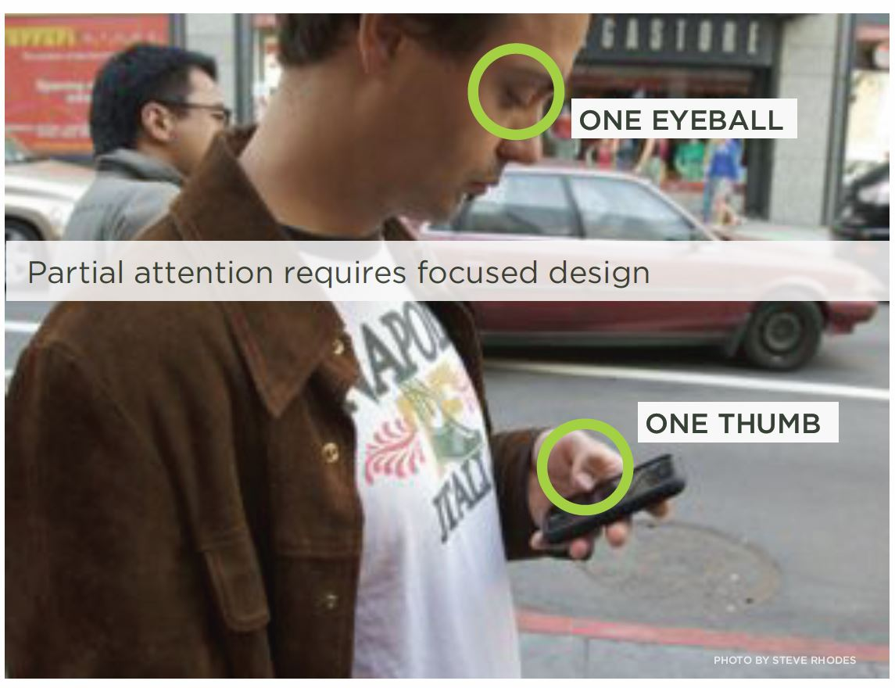
Context of use!

Slide 7
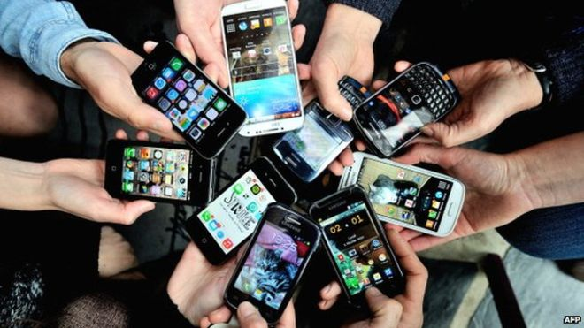

Heterogeneity
Devices
People

Slide 8
You are not your users!

Slide 9

Required skills
In order to successfully master the mobile app design process, lots of skills are required
Some fall in the general domain of computer engineering (problem analysis, overall software architecture, coding, testing, …)
Some fall, instead, in the broader field of human sciences (physiology, psychology, sociology, …)
Others regard work organization (project management, task subdivision, leadership, …)
Given this fact, a multi-disciplinary approach will be followed
You will be taught some lectures from psychologists and designers in order to learn some basic principles of mobile interaction design

Slide 10



Common intent
During labs, psychologists, designers and engineers will guide and review your work in order to…
Create an app
users love to use!

Slide 11
Course organization
We will cover four main areas of knowledge
The Kotlin programming language, as a foundation for writing Android applications
The Android framework, with its peculiarities and APIs
The User Centered Design process, and its implications on the overall user experience
The team working experience, as a preparation to the real working environment
Lab session will be held fortnightly, with the aim to reinforce and deepen the understanding of the material presented during the lectures
Lab assignments will be graded and contribute to the exam score
The implementation of a medium scale project to be delivered by the end of the course will complete your learning process

Slide 12
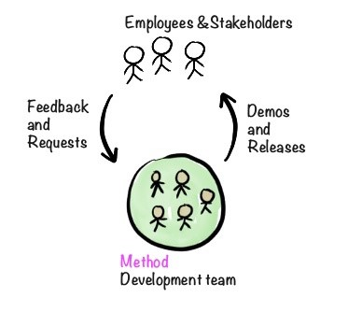
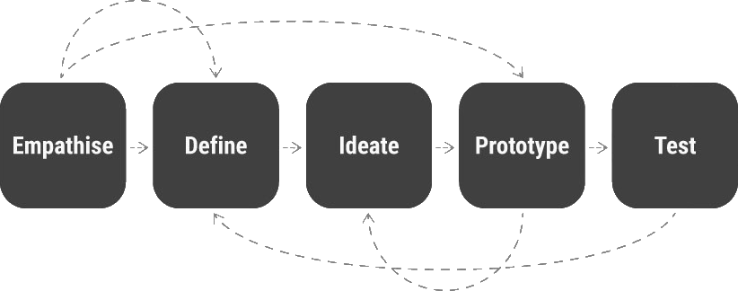
Design thinking
The overall development process will follow the design thinking approach
First of all, think and empathize with
users
the possible use cases
the consequent design of the app (information architecture, interaction and visual design)
Only then, start coding and check your results with users
Keep agile
Set goals
Provide tests
Share your results and materials on GitHub
Collaborate using Slack
Weekly review your work

Slide 13
Overall course assignment
Create an app that supports operating inside a team
Users can:
Subscribe to the system and manage their personal profile
Create new teams and manage their own participation to existing ones
Invite other users to join the team they have created
Create a new single or recurring task to be performed by a team and set its schedule
Update the state of a task, document the work done with pictures and text, report the consumed effort and resources
Have a clear visualization of what has been done and what has to be done, yet
Communicate in a structured way with other members
Groups are encouraged to propose extensions to these basic requirements

Slide 14

Course grading
Written exam: up to 18 points
Lab sessions: up to 10 points
Final project: up to 5 points

Slide 15

Setup your group
Both lab sessions and the final project will be carried out in groups of FOUR people
Group should be setup by Monday March 18th 2024, 24.00 – before the first team lab session
Send me an e-mail message having subject "MAD-24-GroupSetup" with the full name and student ID of the four members
Groups can be consulted at the following spreadsheet
https://docs.google.com/spreadsheets/d/1DKTqzizsTy-g3vg1F46tLUJwl9-vLGnV2j15DCbT2E8/edit?usp=sharing

Slide 16

First assignment
Have a look to existing teamwork management applications and try to answer to the following questions:
What are the main features they offer?
How are teams managed?
What features are they lacking (if any) with respect to the proposed scenario?

